Slide 1
AI BASED DISCOURSE FOR BANKING INDUSTRY
GUIDED BY
Mr.Ratheesh Kumar
INFORMATION TECHNOLOGY
SRI KRISHNA COLLEGE OF
ENGG & TECH COIMBATORE
641008
TEAM MEMBERS
Ajithkumar P(20EUIT501)
Aravind S(20EUIT502)
Arsaad S(20EUIT503)
Deena P(19EUIT033)

Slide 2
ABSTRACT
Banks are already offering a wide variety of products and services, integrated with technology and automation.
This study examined the evolution, adoption, implementation and future opportunities of leveraging Artificial Intelligence (AI) for successful strategy implementation in India’s banking sector.
The implementation of chatbot technology is evolving rapidly in the banking industry.
Aim of the present paper is to identify the factors that influence consumers’ intention to use chatbot technology applied in the banking industry.

Slide 3
PROBLEM STATEMENT
CUSTOMER SEGMENT(S) New customer who would like to learn more about bank & how to create account | CUSTOMER CONSTRAINTS Network connection is required Safety & privacy concern | AVAILABLE SOLUTIONS Customers care telephone lines & staff at bank’s are available to clear customers queries
JOB-TO-BE-DONE/PROBLEMS Answering customer queries correctly & quickly Cost & Time efficiency | PROBLEM ROOT CAUSE Banking can initially be a slightly complicated task People sometimes want guidance or support while performing certain operations | BEHAVIOUR Banking customers usually have queries related to creating a bank account,loans or general banking queries Rely on customer care line or vist bank
TRIGGERS Word of mouth about how convenient & easy it is to use | YOUR SOLUTION Customers can access AI based chatbot that can be placed in the bank’s website | CHANNEL of BEHAVIOUR They search the Web for answer to their queries which are usually scattered & are not reliable

Slide 4
LITERATURE SURVEY
BANKING WITH A CHATBOT – A STUDY ON TECHNOLOGY ACCEPTANCE
DESCRIPTION :
The implementation of chatbot technology is evolving rapidly in the banking industry, yet customer acceptance is behind. The aim of the present paper is to identify the factors that influence consumers’ intention to use chatbot technology applied in the banking industry. The measurement development and hypotheses were based on the technology acceptance model extended with compatibility, customers’ perceived privacy risk and awareness of the service

Slide 5
LITERATURE SURVEY
ADVANTAGES :
There are several managerial implications of this study for the banking sector.
First, significant effects of perceived compatibility and perceived usefulness on behavioral intention indicate that consumers expect banking chatbots to be compatible with their lifestyle and to provide benefits for them

Slide 6
LITERATURE SURVEY
DISADVANTAGES :
While the current study adds to the existing literature, its limitations should be acknowledged.
First, the questionnaire respondents were mainly young, highly educated individuals whose actions may vary somewhat from the population average.
Thus, the study sample is not representative and the findings are not generalizable.

Slide 7
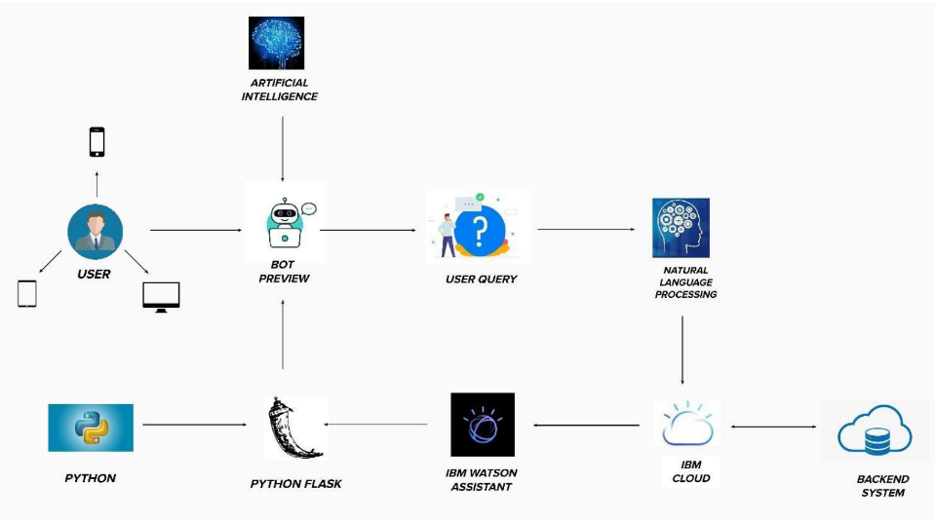
PROPOSED ARCHITECTURE

Slide 8
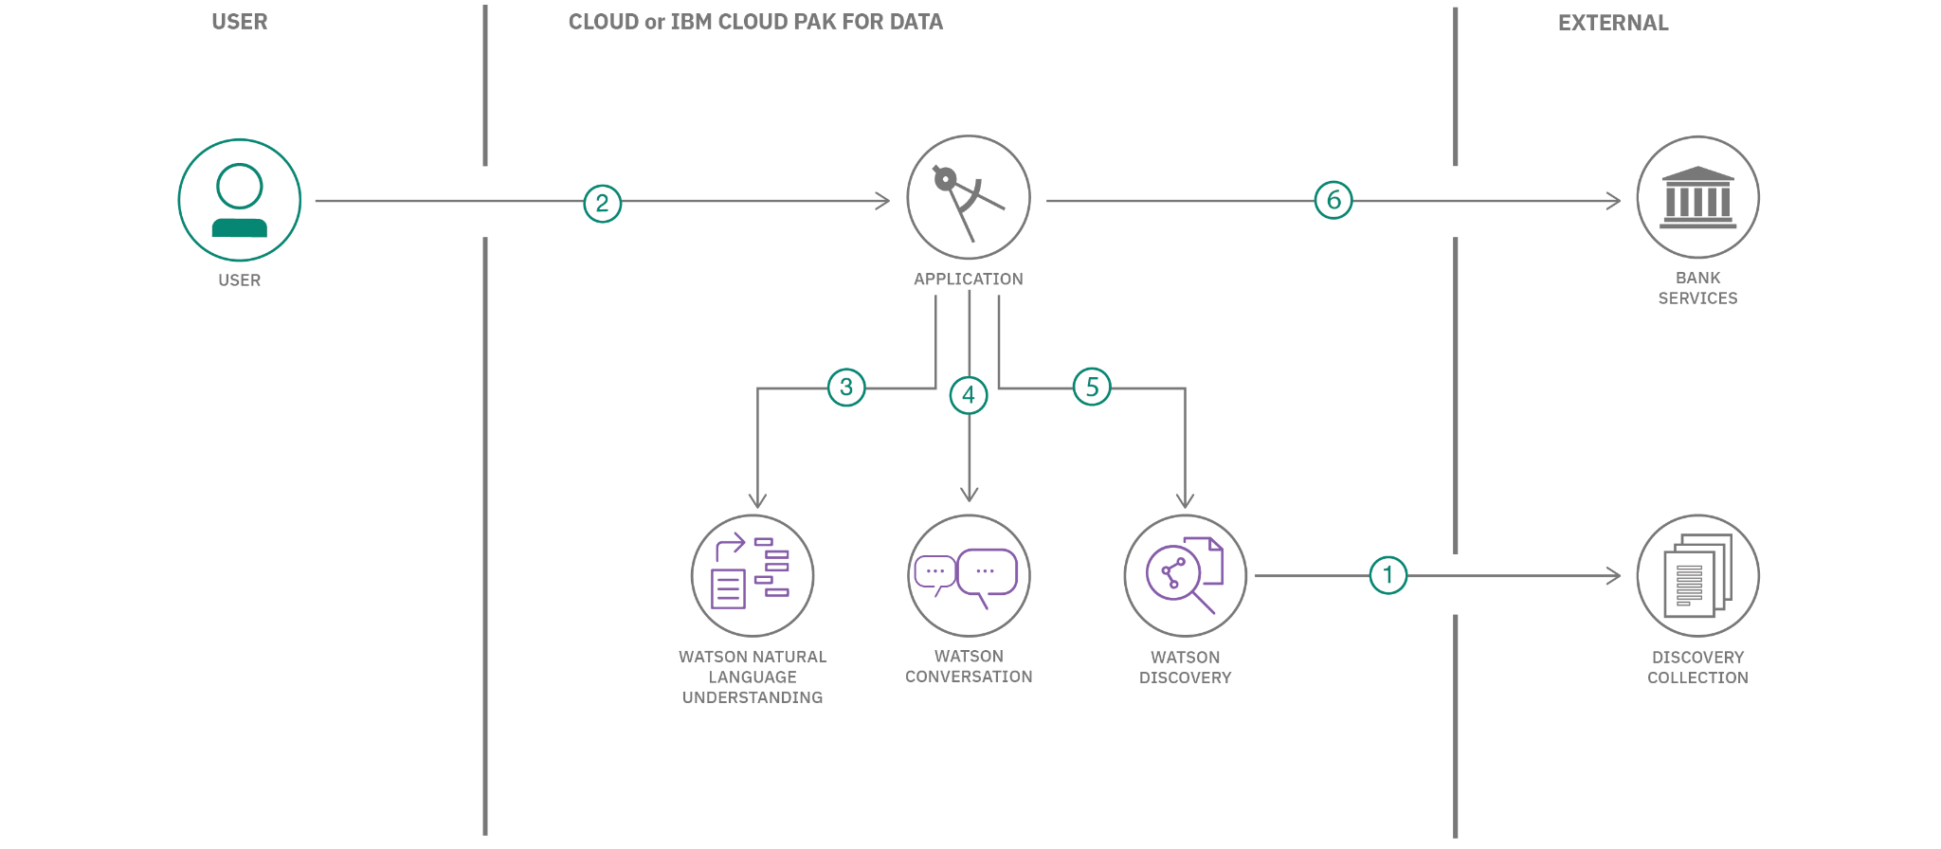

Slide 9
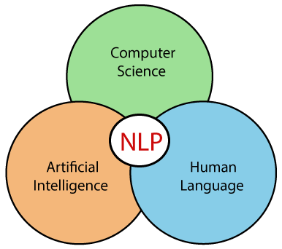
NATURAL LANGUAGE PROCESSING

Slide 10

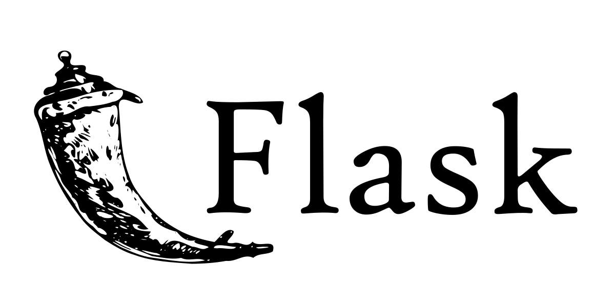
Server-Side

Slide 11


FRONT-END DEVELOPMENT

Slide 12

IBM WATSON

Slide 13
WHAT IS THE NEED OF AN CHATBOT?.....
A CHATBOT is a software application used to conduct an online chat conversation via text or text-to-speech.

Slide 14
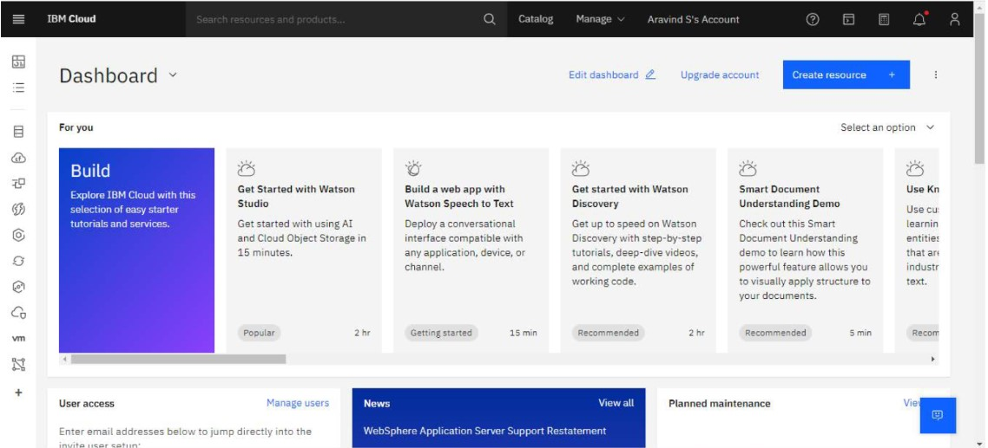
IBM WATSON

Slide 15
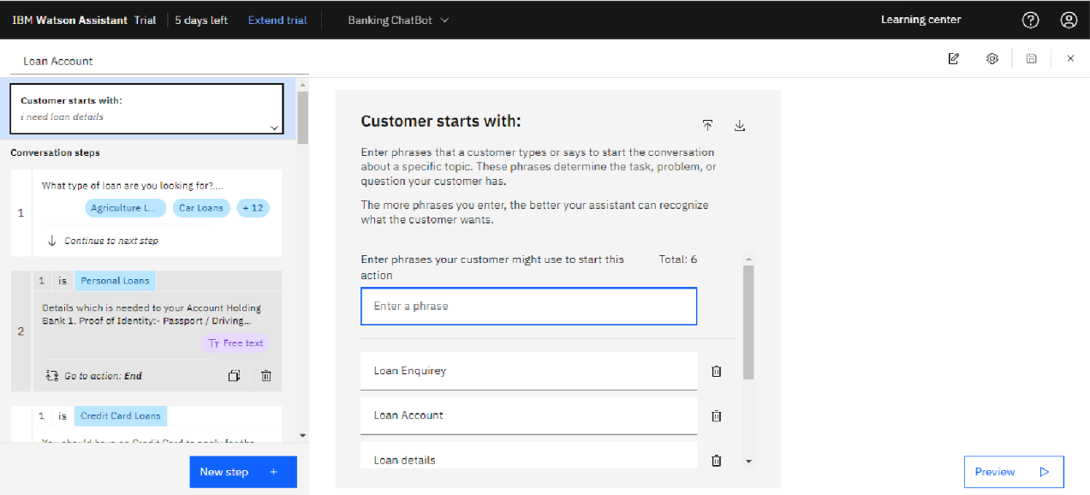

Slide 16
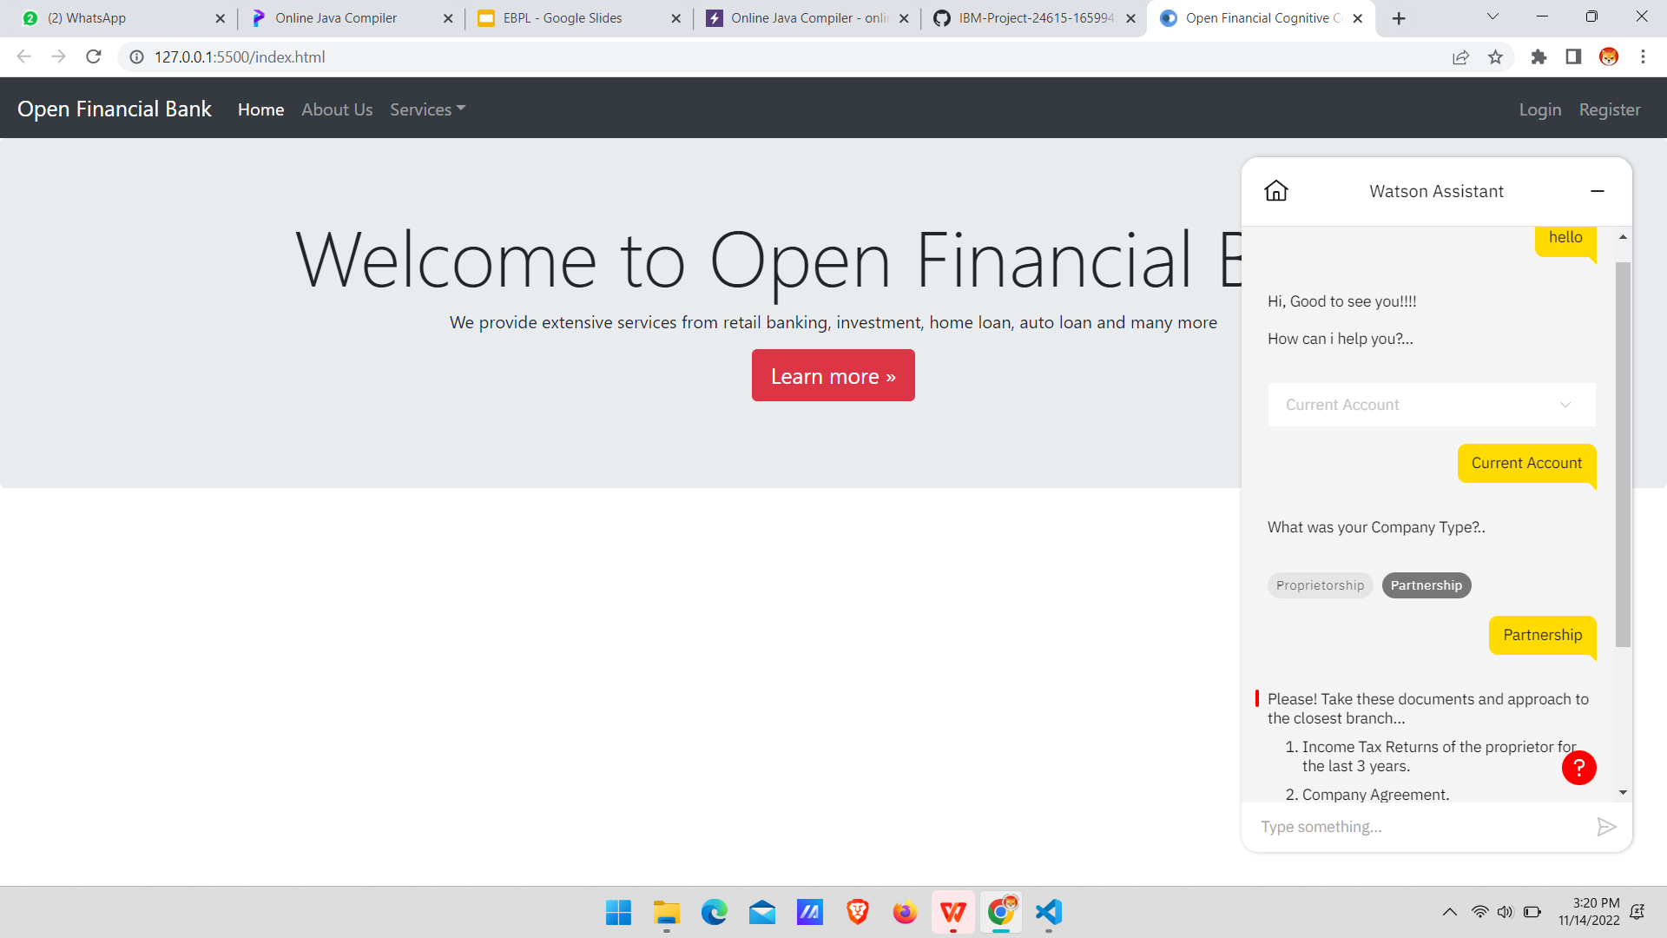

Slide 17
CONCLUSION
Thus this project banking bot will be more efficient while it is been put into practice and it helps the customers to easily perform the user’s action of performing various banking tasks.
This banking bot will be really helpful when it is been integrated with the payment gateway. Still no such development like this is not been implemented in real time environment.
When this is been implemented in the real time the customers will be able to access all the banking information from a single integrated site that can be any like social media or web application.

Slide 18
REFERENCES
[1] Amir Shevat , Creating Conversational Experiences “Designing Bot” May 2017
[2] B Setiaji, Chat bot using knowledge in database ”Human to Machine” Mar 2016
[3] Srini Janarthanam, Hands on chat bot and conversation Dec 2017
[4] Michael Justao Yuan, Building Intelligent
[5] Micheal Washington, Introduction to Microsoft Bot 2016
[6] Rashid Khan, Anik Das, Build Better Chat Bot Dec 2017

Slide 19
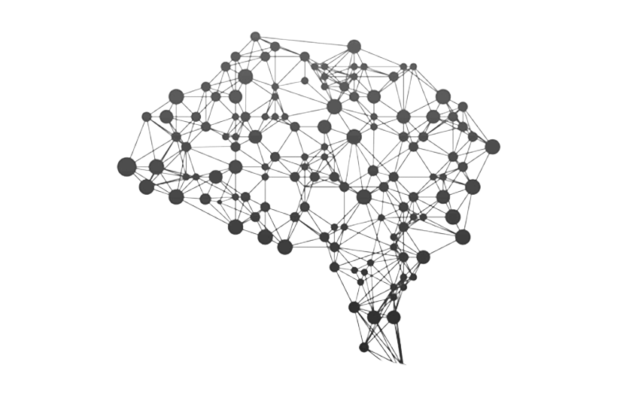
THANK YOU

